Slide 1
Module 3 Introduction to Computation for Brain Sciences Professor Adam Hampshire
https://github.com/dragos-gruia/MSc-TranslationalNeuroscience-Module3

Slide 2
Module Aims
Introduction to the types of computational techniques used in brain sciences
Lift the hood / demystify (beware the black box)
Practical focus (doing as opposed to listening)
Learn about the relationship between brain function and cognition
Network science / network dynamics
Normal and abnormal brain function
Inter-Individual differences
Gain foundation skills in Python programming
Fundamentals of programming
Data handling
Pipeline development
Improve scientific writing skills
hypothesis formulation & testing
inference
Leads particularly well into computational project/workstream, but skills gained are more broadly transferable

Slide 3
Python Tutorials
Each day is a stand alone workshop
The focus is on learning through application
Workshop structure
Brief morning introduction to the workshop
Tutorial walkthroughs in the morning, learning how to program code for handling different datatypes
Afternoon session – apply what you have learnt to a new dataset/problem
Code unsupervised
TAs will be in person to answers Qs
Please make the most use possible of your TAs and ask them difficult questions
Two out of 7 workshops (not day 1) to write up and hand in
Write up must be undertaken independently - text will be compared
Tutorials are all in Python (Jupyter notebook) and are available from the links on BlackBoard.
Extensive materials on Python are available on the internet

Slide 4
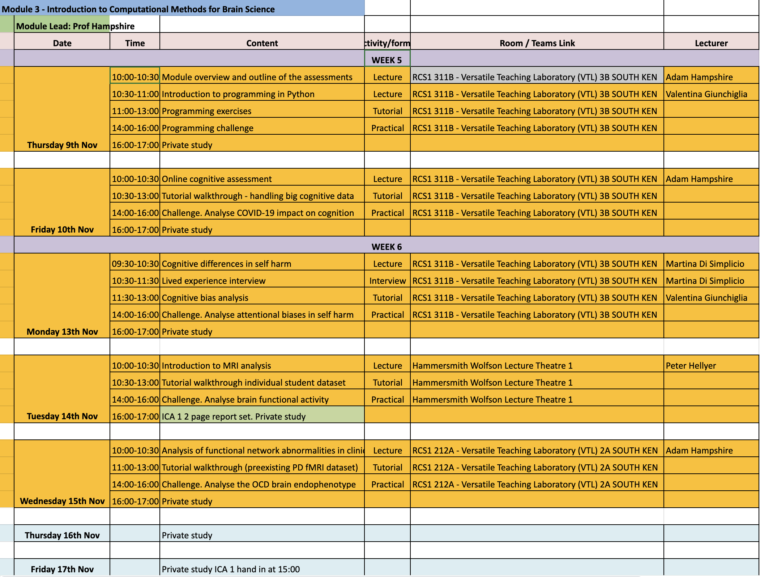

Slide 5
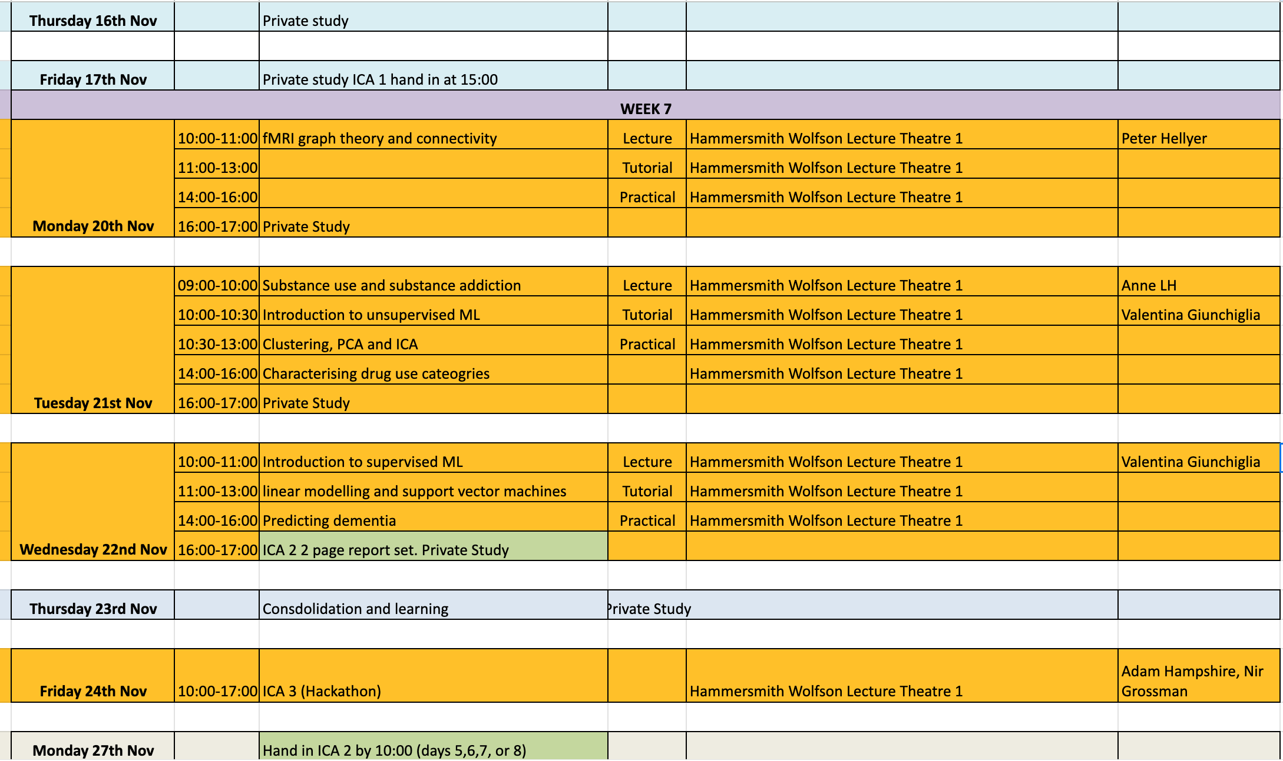

Slide 6
Assessment
Workshop write ups (60%)
Assess understanding of how computational methods can be applied to answer translational neuroscience research questions
2 out of 7 workshops (not day 1)
3 pages including figures, 11 font & 2 cm margins
State hypothesis, explain concisely what you did, what your results were, and interpret, including contextualizing with background literature
Hackathon (40%)
Assess performance when solving a computational research problem under time pressure
Mixture of group and individual work, with individual assessment
Define the hypothesis
Design the analysis pipeline
Implement it
Interpret and critically evaluate

Slide 7
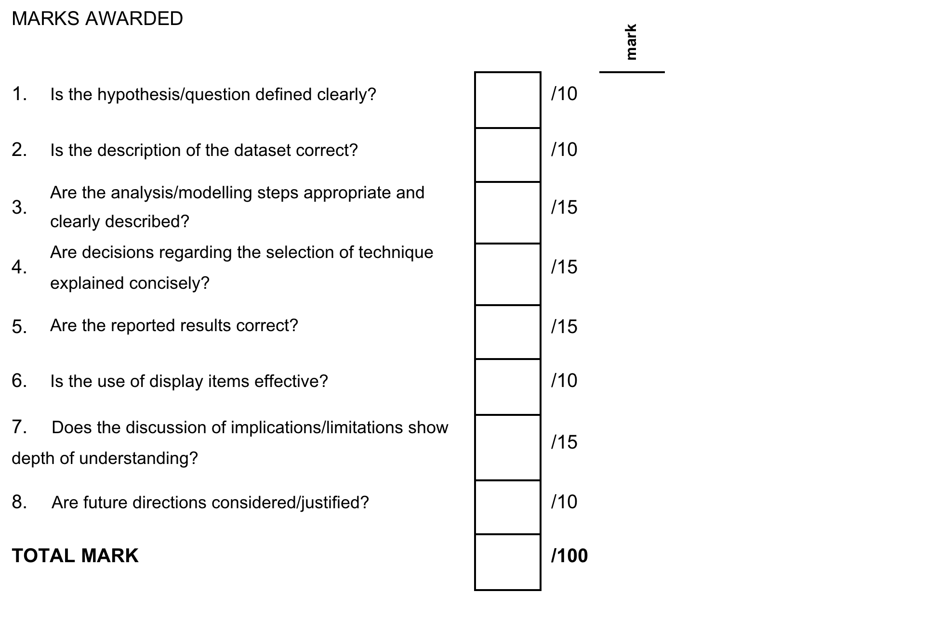
Assessment – Lab Reports (2)
Example from day 2.
Explore the functional connectivity of the data: try at least three spatially different 'seed' voxels and produce maps of how they are connected to the rest of the brain. Briefly, what can you infer from the statistical maps?
As well as functional connectivity, produce a statistical map for head motion? Briefly, what are the implications of this for functional connectivity?
Which brain regions activate during the task?
You should prepare a brief report (no longer than 3 pages in 11-point font 2cm margins) of these analyses, containing figures of statistical maps as appropriate.

Slide 8
Assessment – Hackathon
Assessed on performance when solving a computational research problem under time pressure
Mixture of group and individual work, with individual assessment
Define the hypothesis
Design the analysis pipeline
Implement it
Interpret and critically evaluate

Slide 9
Example Hackathon Mission
Questions
Schedule
Longitudinal questionnaire data have been collected from >20,000 people at two timepoints. Half the participants were surveyed early in 2020 and then in Christmas 2020-21. The other half were surveyed in May 2020, mid lockdown, and then again in Christmas 2021, mid resurgence. A subset of the measures taken have been curated for you to analyse.
Work in groups to address scientific questions from the data
Select a combination of questions to address
Marks will relate to the number and difficulty of questions answered
Recommendations include (but are not limited to)
Easy | What demographic has been sampled in this study?
Intermediate | How does mental health relate to age & other variables at baseline or during the pandemic?
Intermediate | Has mental health changed during the pandemic?
Difficult | Which sub-populations have been most affected?
Advanced | To what degree can mental health be predicted from demographic and lifestyle variables?
You have full access to the Internet, the website and your notes during this assessment but should not work across groups
You can grab food/drinks/coffee at any point
10:20-10:40
Stage 1 | Individual planning brainstorm
Produce up to 2 slides defining your (1) scientific question/s, (2) hypothesis/es, and (3) proposed analysis approach/steps
1
10:40-14:00
Stage 2 | Group planning brainstorm
Agree scientific question/s, hypothesis/es, and analysis steps/approach to implement.
Stage 3 | Implementation
Undertake the analyses, Make (commented) code, Make slides with aims/pipeline and results (6 slides max!)
2
14:00-14:20
Stage 4 | Individual interpretation brainstorm
Produce 2 slides with (1) key implications and (2) limitations / future directions, both in bullet point form.
3
14:20-15:00
Stage 5 | Group implications brainstorm & presentation
Agree final 2 slides for implications, create 10 min group presentation
4
15:30-17:00
Stage 6 | Group presentation
Present your results to the other groups. 10 minutes per group. Slides as above.
a.hampshire@imperial.ac.uk
group_stage_name.ppt in filenames nirg@imperial.ac.uk

